Slide 1
Chapter 9
UNSUPERVISED LEARNING:
Clustering
Part 1
Cios / Pedrycz / Swiniarski / Kurgan

Slide 2
Outline
What is Clustering?
- Categories of clustering methods
- Similarity measures
Partition-Based Clustering
Hierarchical Clustering
Model-Based (mixture of probabilities)
clustering
Scalable Clustering
Grid-Based Clustering
Cluster Validity
Clustering of Large Datasets
© 2007 Cios / Pedrycz / Swiniarski / Kurgan

Slide 3
What is Clustering?
How do we understand data?
We look for structure in data by revealing groups/clusters.
Clusters are about abstraction of data.
The structure is formed based on similarities between patterns (data).
© 2007 Cios / Pedrycz / Swiniarski / Kurgan

Slide 4
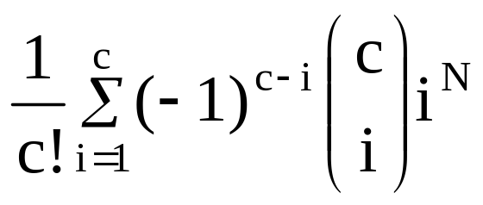
How hard is clustering?
Consider N data points to be split into “c”
groups (clusters). The number of possible splits (partitions) is described as
Even for a small problem of N =100 and c =5 we end up with 10⁶⁷ partitions
© 2007 Cios / Pedrycz / Swiniarski / Kurgan

Slide 5
Categories of Clustering
We distinguish between three main categories (classes) of clustering methods
Partition-based
Hierarchical
Model-based (mixture of probabilities)
© 2007 Cios / Pedrycz / Swiniarski / Kurgan

Slide 6
Partition-Based Clustering
It is also referred to as objective function clustering, relies on the minimization of a certain objective function (performance index)
The result of minimization is a partition matrix and a collection of prototypes
The methods in this class are conceptually and algorithmically appealing
© 2007 Cios / Pedrycz / Swiniarski / Kurgan

Slide 7
Model-Based Clustering
In MBC we assume a certain probabilistic model of data and estimate its parameters, such as mean, covariance matrix, etc.
Mixture density model is the common approach used – we assume that data are a result of a mixture of “c” sources of data and
each source is treated as a separate cluster.
© 2007 Cios / Pedrycz / Swiniarski / Kurgan

Slide 8
Similarity measures
SM are the most fundamental components of every clustering method; they are used to quantify similarity (or dissimilarity) between the data points.
The data with the highest similarity (like the lowest distance) are candidates to form a single cluster.
© 2007 Cios / Pedrycz / Swiniarski / Kurgan

Slide 9
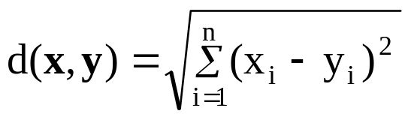
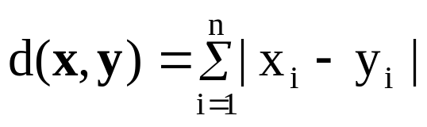
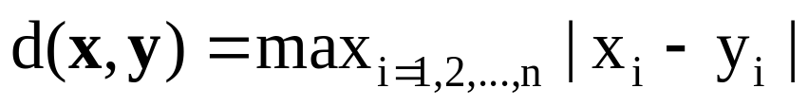
Examples of Distance Functions:
Continuous Data (1)
Euclidean distance (p=2 in Minkowski)
Hamming distance (p=1 in Minkowski)
Tchebyschev distance (p= ∞ in Minkowski)
© 2007 Cios / Pedrycz / Swiniarski / Kurgan

Slide 10
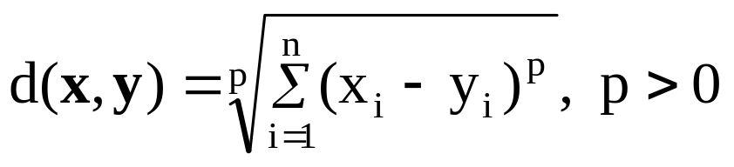
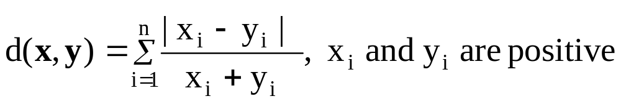
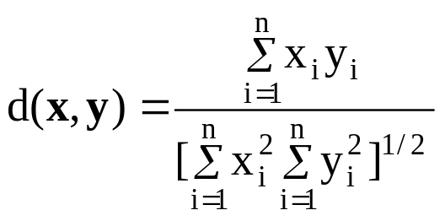
Examples of Distance Functions:
Continuous Data (2)
Minkowski distance
(drawing from Wikipedia)
Canberra distance
Angular separation
© 2007 Cios / Pedrycz / Swiniarski / Kurgan

Slide 11

Examples of Distance Functions:
Discrete Data (1)
Binary data x = [x₁ x₂ …x_{n}]
a- number of occurrences where both x_{i} and y_{i} are 1
d- number of occurrences where both x_{i} and y_{i} are 0
b,c- number of occurrences where x_{i} and y_{i} are different (0-1)
© 2007 Cios / Pedrycz / Swiniarski / Kurgan

Slide 12
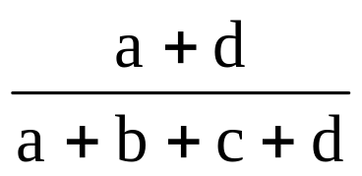
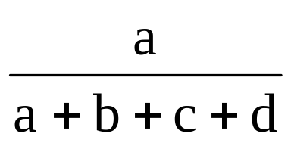
Examples of Distances:
Discrete Data (2)
Binary data x = [x₁ x₂ …x_{n}]
Matching index
Rusell & Rao
© 2007 Cios / Pedrycz / Swiniarski / Kurgan

Slide 13
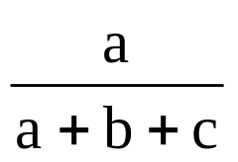
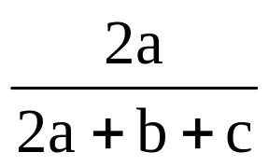
Examples of Distances:
Discrete Data (3)
Binary data x = [x₁ x₂ …x_{n}]
Jacard index
Czekanowski
© 2007 Cios / Pedrycz / Swiniarski / Kurgan

Slide 14
Hierarchical Clustering
HC provides graphical illustration of relationships between the data in the form of dendrogram, which is a binary tree.
There are two approaches to HC:
Bottom – up or agglomerative approach
Top-down or divisive approach
© 2007 Cios / Pedrycz / Swiniarski / Kurgan

Slide 15
Hierarchical Clustering
Agglomerative / bottom-up methods start with each object in the data forming its own cluster, and then successively merge the clusters until one large cluster is formed (that encompasses the entire dataset).
Divisive methods / top-down methods start by considering the entire data as one cluster and then split up the cluster(s) until each object forms its own cluster.
© 2007 Cios / Pedrycz / Swiniarski / Kurgan

Slide 16
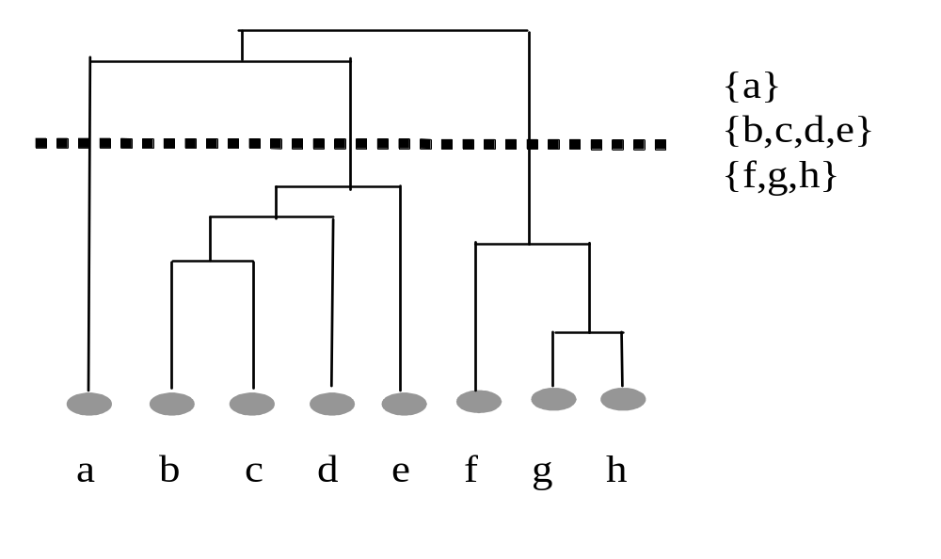
Hierarchical Clustering
Top –down
divisive
Bottom-up
agglomerative
© 2007 Cios / Pedrycz / Swiniarski / Kurgan

Slide 17
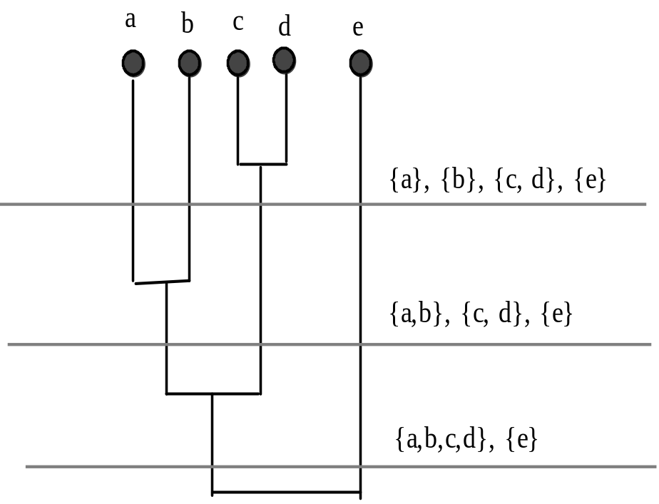
Hierarchical Agglomerative Clustering
number of clusters
at different levels
© 2007 Cios / Pedrycz / Swiniarski / Kurgan

Slide 18
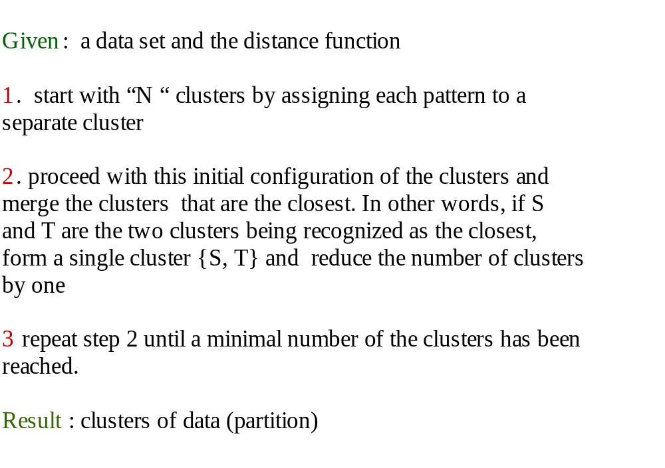
Hierarchical Agglomerative Clustering
© 2007 Cios / Pedrycz / Swiniarski / Kurgan

Slide 19
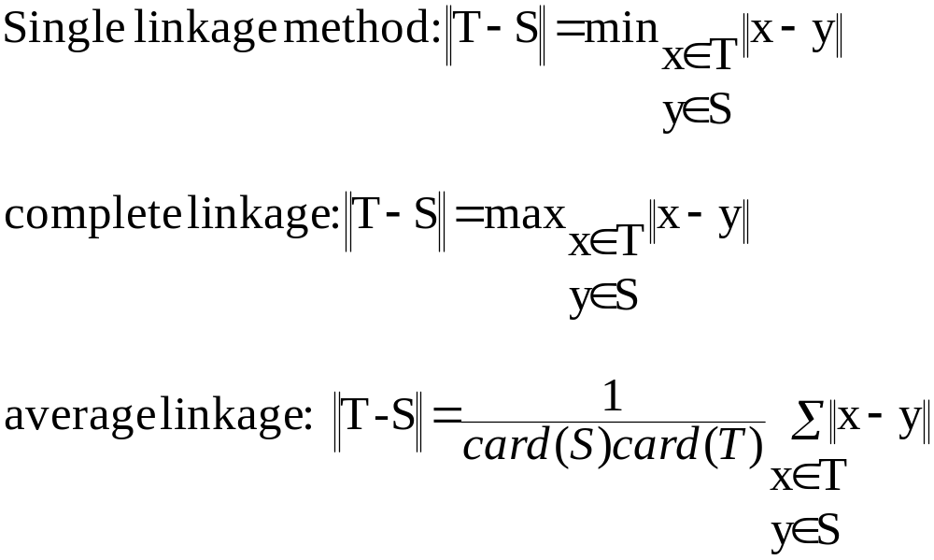
Distance Between Clusters
© 2007 Cios / Pedrycz / Swiniarski / Kurgan

Slide 20
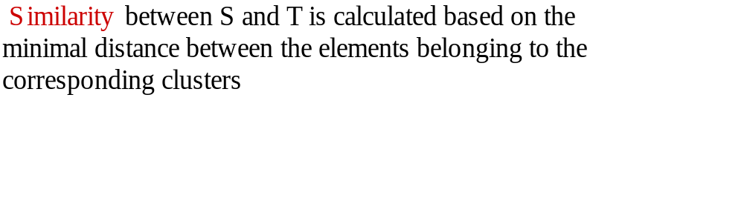
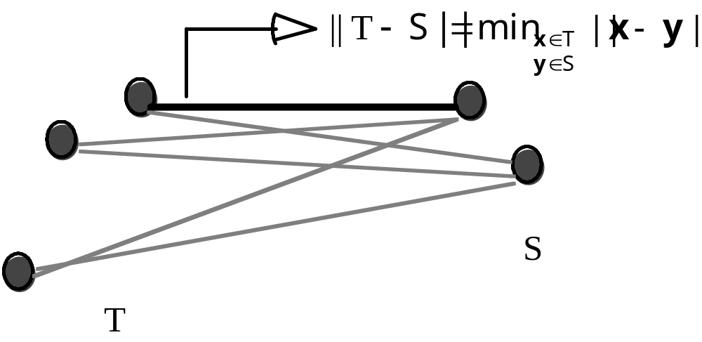
Single Linkage
© 2007 Cios / Pedrycz / Swiniarski / Kurgan

Slide 21
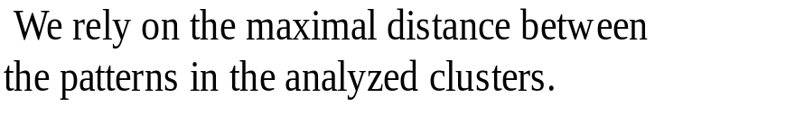
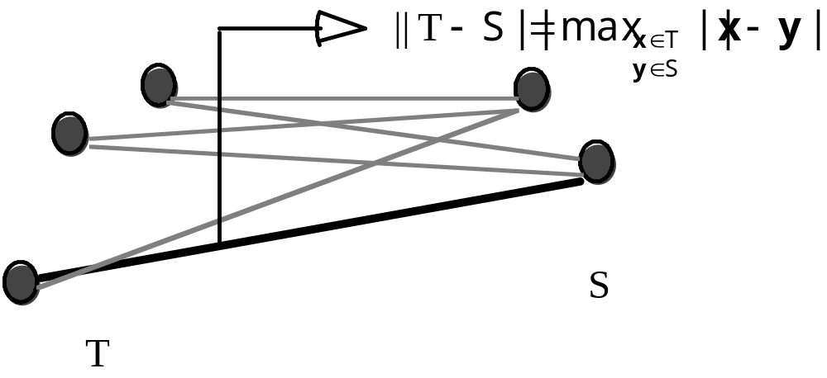
Complete Linkage
© 2007 Cios / Pedrycz / Swiniarski / Kurgan

Slide 22
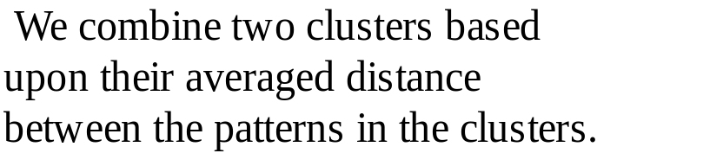
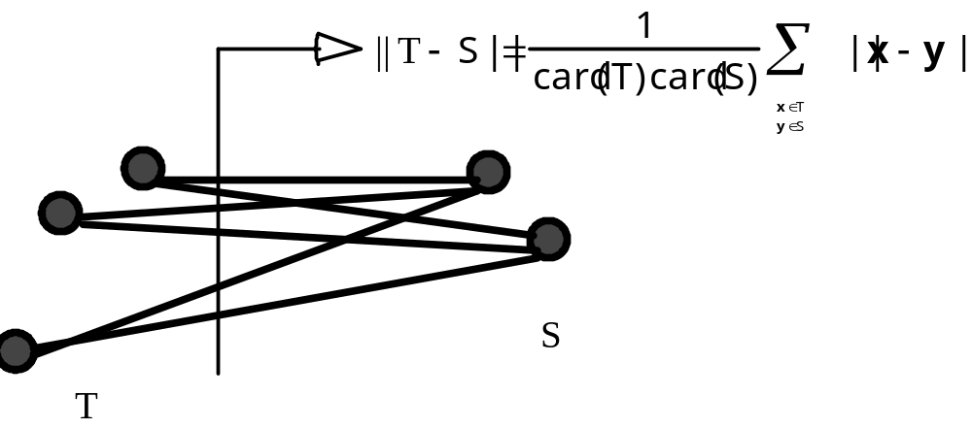
Average Linkage
© 2007 Cios / Pedrycz / Swiniarski / Kurgan

Slide 23
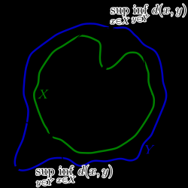
Hausdorff Distance Function
From Wikipedia
© 2007 Cios / Pedrycz / Swiniarski / Kurgan

Slide 24
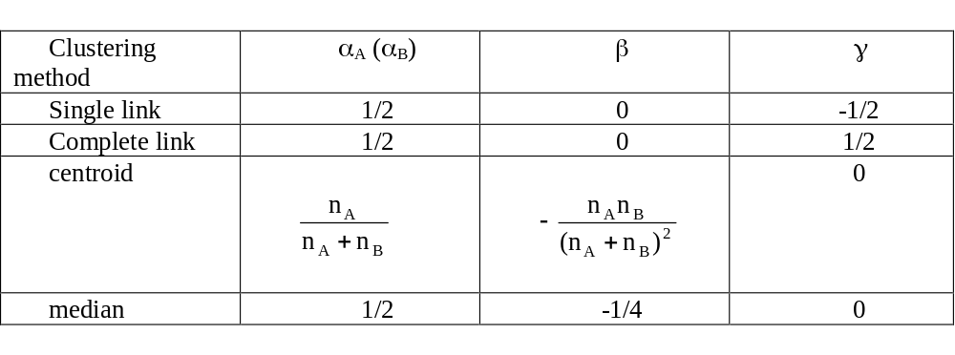
Lance-Williams updating formula
© 2007 Cios / Pedrycz / Swiniarski / Kurgan

Slide 25
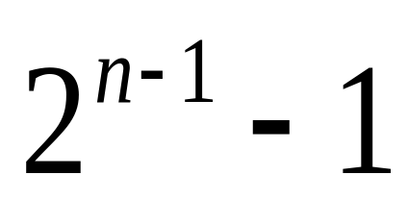
Hierarchical Divisive Method
HD algorithm starts by considering all divisions of the data into two nonempty subsets, which amounts to
possibilities.
© 2007 Cios / Pedrycz / Swiniarski / Kurgan

Slide 26
Hierarchical Divisive Method
However, it is possible to construct divisive methods that do not consider all divisions,
most of which may be incorrect anyway.
One such algorithm is by MacNaughton - Smith (1964)
© 2007 Cios / Pedrycz / Swiniarski / Kurgan

Slide 27
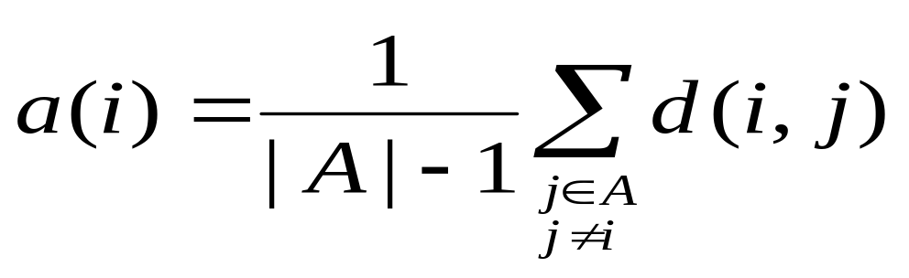
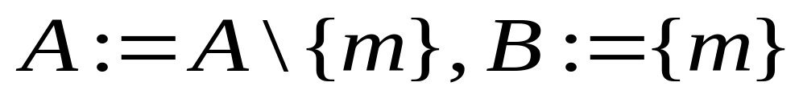
Hierarchical Divisive Method
At first A:=C and B:=∅
1. Move one object at a time from A to B.
  For each object i∈A we compute average dissimilarity to all other objects of A:
  Object m of A for which a(m) is the largest, is moved to B:
© 2007 Cios / Pedrycz / Swiniarski / Kurgan

Slide 28
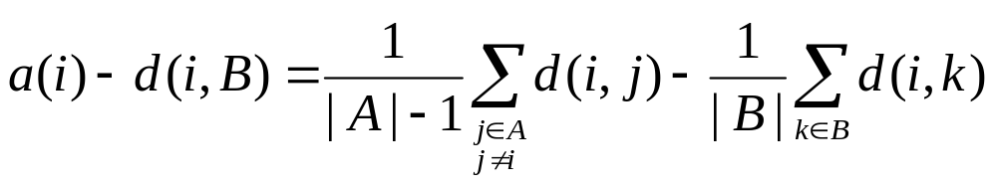
Hierarchical Divisive Method
2. Move other objects from A to B (called the “splinter group”)
  If |A|=1, stop. Otherwise compute a(i) for all i∈A, and the average dissimilarity of i to all objects of B, denoted as d(i,B)
© 2007 Cios / Pedrycz / Swiniarski / Kurgan

Slide 29
Hierarchical Divisive Method
Select the object h∈A for which
If a(h)-d(h,B) > 0 ⇒ move h from A to B, go to 2
If a(h)-d(h,B) ≤ 0 ⇒ the process stops
The division of C into clusters A and B is complete.
© 2007 Cios / Pedrycz / Swiniarski / Kurgan

Slide 30
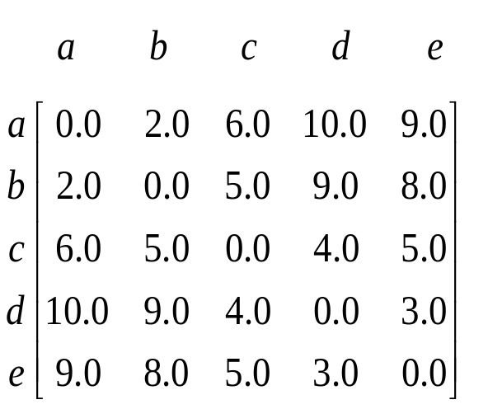
Hierarchical Divisive Method
    Object Average Dissimilarity to the Other Objects
    a (2.0 + 6.0 + 10.0 + 9.0)/4 = 6.75
    b (2.0 + 5.0 + 9.0 +8.0)/4 = 6.00
    c (6.0 + 5.0 + 4.0 + 5.0)/4 = 5.00
    d (10.0 + 9.0 + 4.0 + 3.0)/4 = 6.50
    e (9.0 + 8.0 + 5.0 + 3.0)/4 = 5.25
In our example, object a is chosen to initiate the splinter group.
At this stage we have groups A={b,c,d,e} and B={a}, but we don’t stop here.
© 2007 Cios / Pedrycz / Swiniarski / Kurgan

Slide 31
Hierarchical Divisive Method
Average Dissimilarity
Average Dissimilarity to Objects of
Object to remaining Objects Splinter Group Difference
b (5.0+9.0+8.0)/3≈7.33 2.00 5.33
c (5.0+4.0+5.0)/3≈4.67 6.00 -1.33
d (9.0+4.0+3.0)/3≈5.33 10.00 -4.67
e (8.0+5.0+3.0)/3≈5.33 9.00 -3.67
Therefore, object b changes sides, so new splinter group is B={a, b} and the remaining group becomes A={c, d, e}
Average Dissimilarity
Average Dissimilarity to Objects of
Object to remaining Objects Splinter Group Difference
c (4.0+5.0)/2=4.50 (6.0+5.0)/2=5.50 -1.00
d (4.0+3.0)/2=3.50 (10.0+9.0)/2=9.50 -6.00
e (5.0+3.0)/2=4.00 (9.0+8.0)/2=8.50 -4.50
© 2007 Cios / Pedrycz / Swiniarski / Kurgan

Slide 32
Objective Function Clustering
Develop and optimize a partition matrix
so that a certain performance index is optimized.
The lower the value of the objective function, the better.
© 2007 Cios / Pedrycz / Swiniarski / Kurgan

Slide 33
Objective Function Clustering
Objective function
Minimization
Structure
© 2007 Cios / Pedrycz / Swiniarski / Kurgan

Slide 34
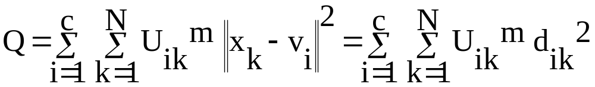
Objective Function Clustering
Depends on minimization of a certain performance index Q
c – number of clusters
U – partition matrix
© 2007 Cios / Pedrycz / Swiniarski / Kurgan

Slide 35
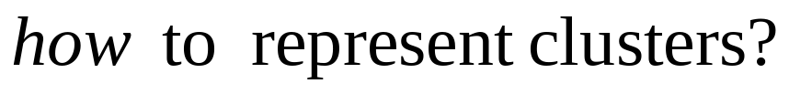
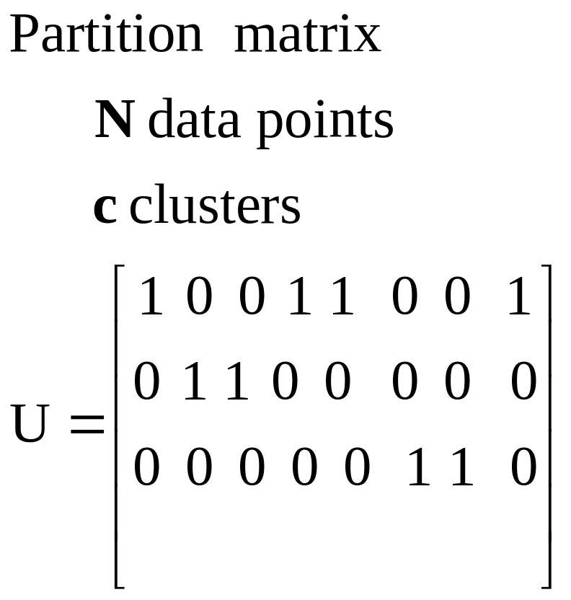
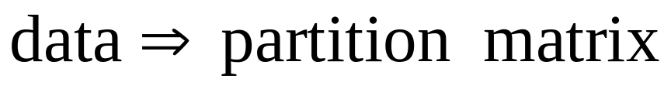
Clustering: representation issues
© 2007 Cios / Pedrycz / Swiniarski / Kurgan

Slide 36
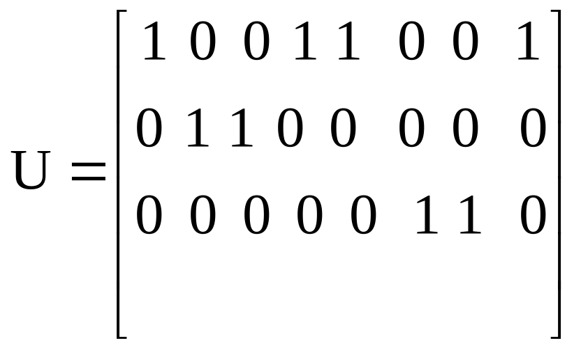
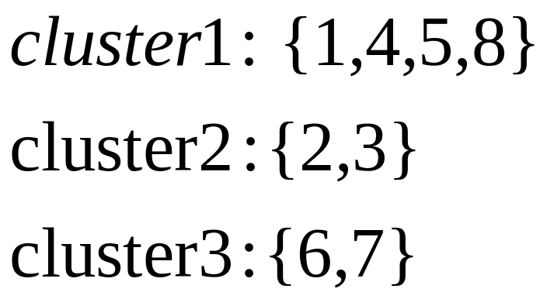
Partition Matrix
© 2007 Cios / Pedrycz / Swiniarski / Kurgan

Slide 37
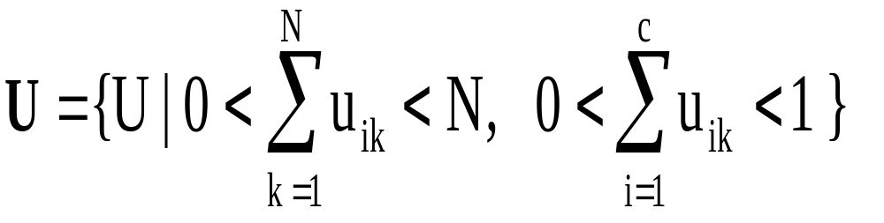
Objective Function Clustering
Characteristics of partition matrices:
© 2007 Cios / Pedrycz / Swiniarski / Kurgan

Slide 38
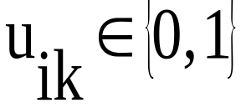
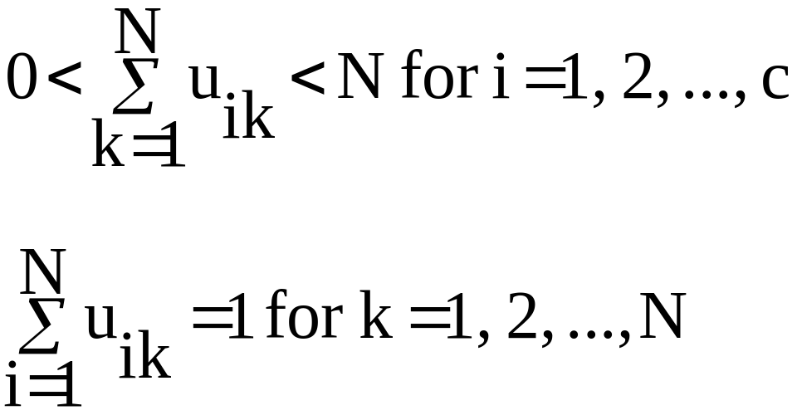
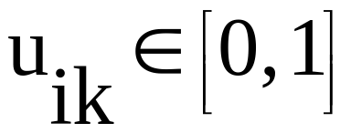
Objective Function Clustering
Conditions for U
set oriented clustering
fuzzy set clustering
© 2007 Cios / Pedrycz / Swiniarski / Kurgan

Slide 39
Objective Function-Based Clustering
Clustering is guided by the minimization of some
objective function/performance index Q
Representation of structure in the form
Partition matrix U = [u_{ik}], i=1,2,…,c; k=1, 2,…,N
Prototypes v_{i}, i=1,2,…, c
© 2007 Cios / Pedrycz / Swiniarski / Kurgan

Slide 40
Objective Function Clustering
Algorithm:
    Given: the (guessed!) number of clusters (c), decide on the similarity function
    (and on the value of the power factor (m) - for fuzzy clustering only)
    Compute the prototypes (v) and update the partition matrix (U) based on the conditions of the minimized objective function
    Result: partition matrix and prototypes
© 2007 Cios / Pedrycz / Swiniarski / Kurgan

Slide 41
K - means Algorithm
Input
c = number of clusters
d = distance function
m = power (fuzziness) factor
  not used in hard K- means
t = termination criteria
  Amount of movement between clusters
v = cluster centers
  Randomly chosen each run
Output
  U = partition matrix
  V = Cluster centers
© 2007 Cios / Pedrycz / Swiniarski / Kurgan

Slide 42
K - means Algorithm
  Termination criteria
  When the summed difference of the old and new partitions (partition matrices) is less than a threshold
    Hard
      U_{new} - U_{old} == 0;
    Fuzzy
      U_{new} - U_{old} < user chosen number
      (like 0.0001)
© 2007 Cios / Pedrycz / Swiniarski / Kurgan

Slide 43
K - means Algorithm
Minimizes the objective function by allocating data points to different clusters
    Given: the number of clusters c
      select initial c means
      calculate distance between the pattern and the means of the clusters
      allocate the pattern to the cluster whose mean is nearest to this pattern
      recalculate the mean of the cluster from the patterns allocated to it
      repeat 2-4 until a termination criterion is satisfied
      Result: a collection of means (prototypes) of the clusters
© 2007 Cios / Pedrycz / Swiniarski / Kurgan

Slide 44
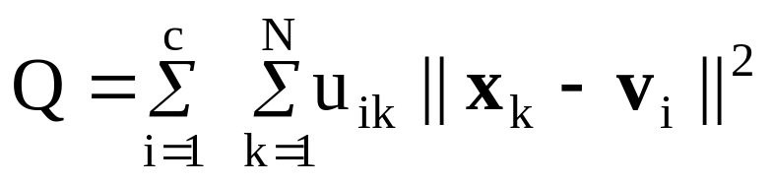
K-Means Clustering Algorithm (1)
Objective function
Minimize Q
subject to constraints
u_{ik} = 0 or 1
© 2007 Cios / Pedrycz / Swiniarski / Kurgan

Slide 45
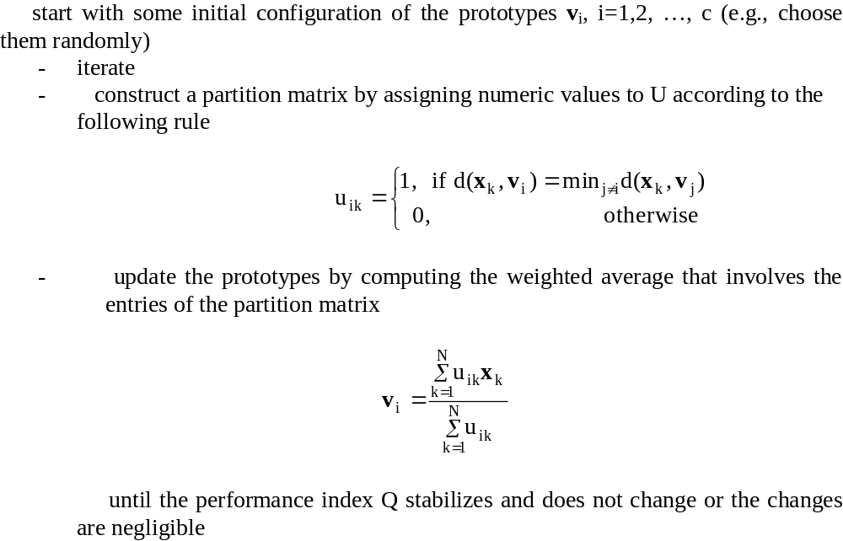
K-Means Clustering Algorithm (2)
© 2007 Cios / Pedrycz / Swiniarski / Kurgan

Slide 46
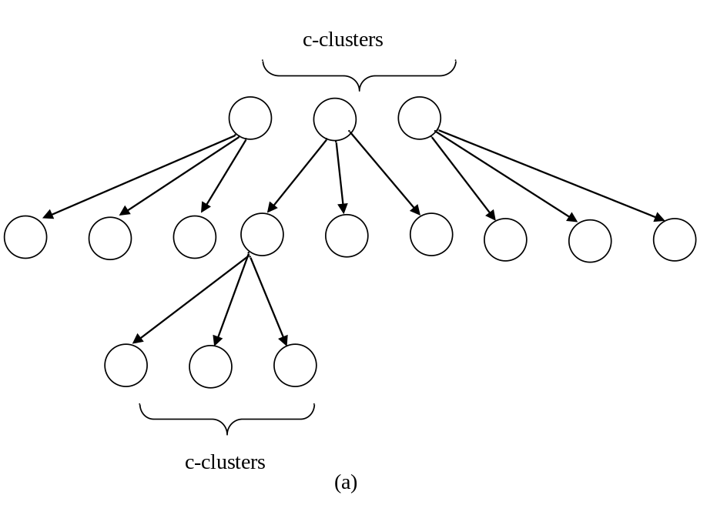
Objective Function-Based Clustering:
Growing the Hierarchy of Clusters
Develop “c” clusters; split
the most heterogeneous cluster
into “c” clusters, etc.
© 2007 Cios / Pedrycz / Swiniarski / Kurgan

Slide 47
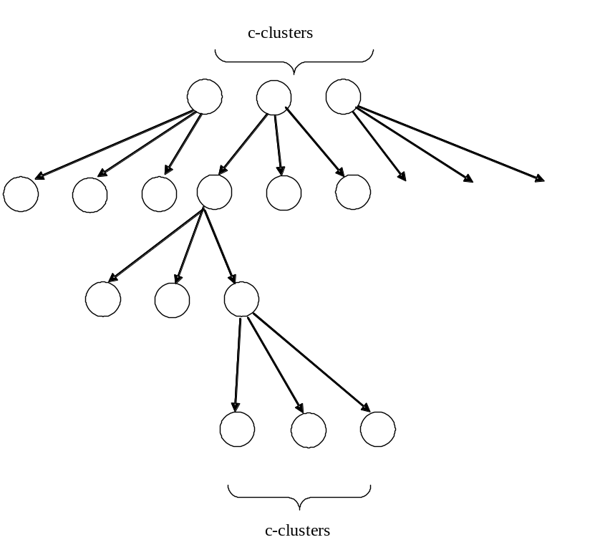
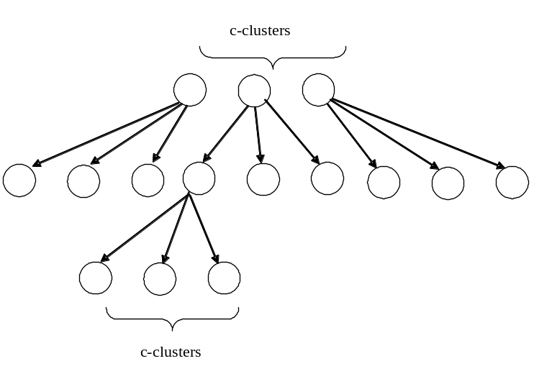
Growing the Hierarchy of Clusters
balanced growth
imbalanced growth
© 2007 Cios / Pedrycz / Swiniarski / Kurgan

Slide 48
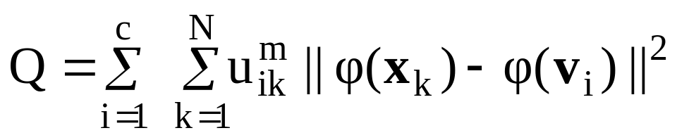
Kernel-Based Clustering
Original data x, y,… in n-dimensional space are transformed
through some mapping φ into elements in m-dimensional space
where m >>n.
Objective function in the new space
© 2007 Cios / Pedrycz / Swiniarski / Kurgan

Slide 49
Kernel-Based Clustering
Given the dimensionality of a new space, m >>n,
we calculate in the new space a kernel function K(x,v)
as a scalar product
K(x,v) = φ^{T}(x)φ(v)
In case of Gaussian kernel
K(x,v) = exp(- ||x-v||²/σ²)
© 2007 Cios / Pedrycz / Swiniarski / Kurgan

Slide 50
K-Medoids Clustering
To enhance robustness of clustering we use medoids instead of prototype mean values
In one-dimensional case it is the median
© 2007 Cios / Pedrycz / Swiniarski / Kurgan

Slide 51
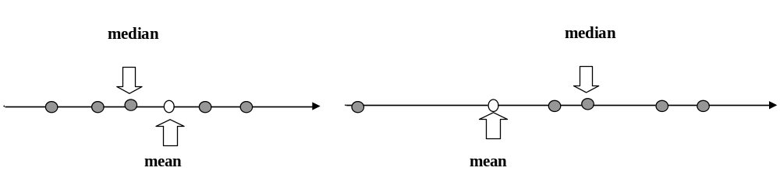
Median as a Robust Estimator
Consider an ordered collection of real data
x₁ <= x₂ <= … <=x_{N}
Median is the central point in this sequence (if N is even) or an average the two points in the middle (if N is odd)
Median is a robust estimator (ordered statistics)
outlier
© 2007 Cios / Pedrycz / Swiniarski / Kurgan

Slide 52
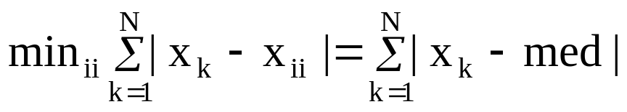
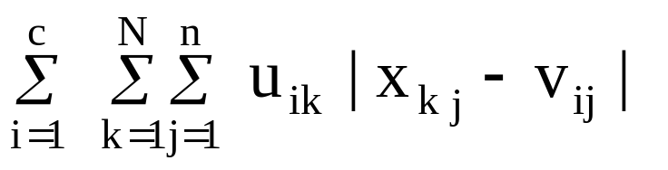
Median as a Robust Estimator
Median is a solution to the minimization problem
We enhance the robustness by considering the objective function
Advantage: one of the original points becomes cluster center
© 2007 Cios / Pedrycz / Swiniarski / Kurgan

Slide 53
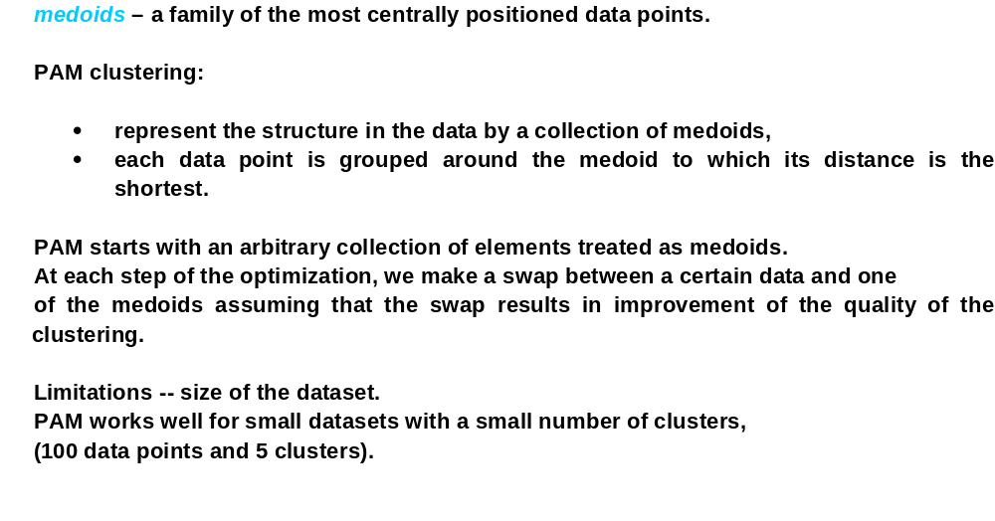
Partitioning Around Medoids (PAM)
© 2007 Cios / Pedrycz / Swiniarski / Kurgan

Slide 54
Clustering Large Applications (CLARA)
Modification of PAM to deal with large data sets:
Instead of processing all data, sample it ,and apply PAM to the sample
K-Medoids clustering:
  PAM
  CLARA
Advantages:
robustness, and
interpretability
© 2007 Cios / Pedrycz / Swiniarski / Kurgan

Slide 55
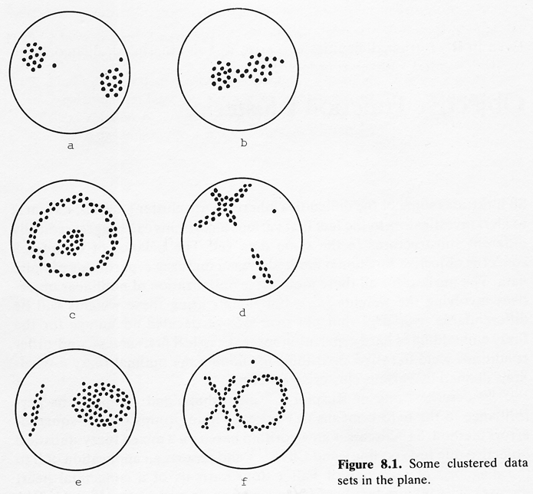
Clustering Challenges – from Bezdek
© 2007 Cios / Pedrycz / Swiniarski / Kurgan

Slide 56
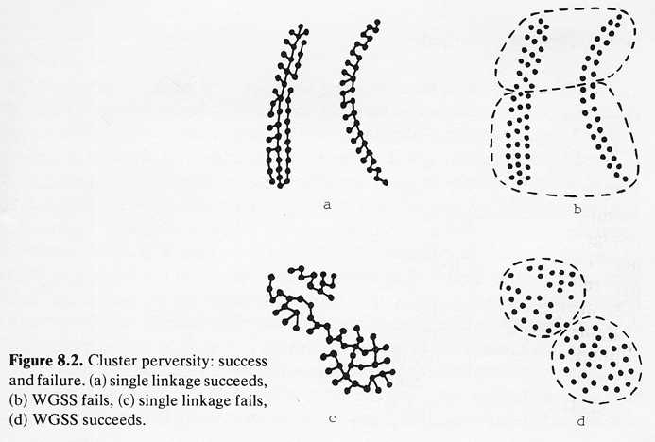
Clustering Challenges – from Bezdek
© 2007 Cios / Pedrycz / Swiniarski / Kurgan

Slide 57



Fuzzy C - Means: Optimization
© 2007 Cios / Pedrycz / Swiniarski / Kurgan

Slide 58




Fuzzy C – Means: Calculations
© 2007 Cios / Pedrycz / Swiniarski / Kurgan

Slide 59



Fuzzy C - Means Algorithm
© 2007 Cios / Pedrycz / Swiniarski / Kurgan

Slide 60

Fuzzy C-Means
How to deal (quantify) data that are in-between clusters?
Consider partial membership to clusters – emergence of fuzzy sets
elements with partial membership
© 2007 Cios / Pedrycz / Swiniarski / Kurgan

Slide 61

Fuzzy C-Means
Partial membership in clusters – fuzzy partition matrix U
Objective function
U = [u_{ik}]; u_{ik} – degree of membership of k-th data to i-th cluster
m – fuzzification coefficient, m>1
||. || - distance function
© 2007 Cios / Pedrycz / Swiniarski / Kurgan

Slide 62

FCM: Algorithm
© 2007 Cios / Pedrycz / Swiniarski / Kurgan

Slide 63
FCM – Algorithm
Design aspects
stopping criterion: termination of iterations
fuzzification coefficient (m) : m>1
Shape of the membership functions
m =2.0 – typical value
m close to 1 – set like shape of membership functions
m higher than 2.0 - spike like membership functions
© 2007 Cios / Pedrycz / Swiniarski / Kurgan

Slide 64
Model-Based Clustering
Mixture of data as an underlying model
Each component described by some conditional probability
density function described by parameters
Parameters estimation of the mixture of data
© 2007 Cios / Pedrycz / Swiniarski / Kurgan

Slide 65

Mixture of Data Model
Maximum likelihood estimation
Given data x₁, x₂, …, x_{N} choose parameters such that
the value of the expression
becomes maximized
© 2007 Cios / Pedrycz / Swiniarski / Kurgan

Slide 66
Scalable Clustering
Clustering algorithms need to be scalable to deal with large data sets
Example algorithms:
Density-Based Clustering (DBSCAN)
OPTICS
DENCLUE
CLIQUE
© 2007 Cios / Pedrycz / Swiniarski / Kurgan

Slide 67


Density-Based Clustering DBSCAN
Based on the concept of ε-neighborhood, N_Pts, and
density-based reachability
N_Pts – number of points falling within the neighborhood
x_{i} is x_{k} density-reachable with parameters ε and N_Pts if
the following conditions are satisfied
Then xi becomes a CORE point
© 2007 Cios / Pedrycz / Swiniarski / Kurgan

Slide 68

DBSCAN: Density-based Reachability
© 2007 Cios / Pedrycz / Swiniarski / Kurgan

Slide 69

DBSCAN Algorithm
© 2007 Cios / Pedrycz / Swiniarski / Kurgan

Slide 70


Grid-Based Clustering
Describe structure in data in the language of generic
geometric constructs – hyperboxes and their combinations
Collection of clusters of different geometry
Formation of clusters by merging adjacent hyperboxes of the grid
© 2007 Cios / Pedrycz / Swiniarski / Kurgan

Slide 71

Grid-Based Clustering
Hyperboxes
© 2007 Cios / Pedrycz / Swiniarski / Kurgan

Slide 72

Grid-Based Clustering Steps
© 2007 Cios / Pedrycz / Swiniarski / Kurgan

